Slide 1

Neo4j
Master :Dr.Bijani
Presented by : Melika Bahmanabadi
13th May 2020

Slide 2
01
Introduction
02
Installation
TABLE OF CONTENTS
03
Structure
04
Neo4j CQL
2

Slide 3
01
Introduction
3

Slide 4
Introduction
Graph Databases and Cypher Query Language (CQL)
written in Java Language
Open source
Highly scalable and schema free(NoSQL)
4

Slide 5
What is a Graph Database?
A graph is a pictorial representation of a set of objects where some pairs of objects are connected by links. It is composed of two elements - nodes (vertices) and relationships (edges).
Graph database is a database used to model the data in the form of graph. In here, the nodes of a graph depict the entities while the relationships depict the association of these nodes.
Other Graph Databases are Oracle NoSQL Database, OrientDB, HypherGraphDB, GraphBase, InfiniteGraph, and AllegroGraph.
5

Slide 6
Why Graph Databases?
Nowadays, most of the data exists in the form of the relationship between different objects and more often, the relationship between the data is more valuable than the data itself.
Relational databases store highly structured data which have several records storing the same type of data so they can be used to store structured data and, they do not store the relationships between the data.
Unlike other databases, graph databases store relationships and connections as first-class entities.
6

Slide 7
RDBMS Vs Graph Database
No | RDMS | Graph Databases
1 | Tables | Graphs
2 | Rows | Nodes
3 | Columns & Data | Properties & its values
4 | Constraints | Relationships
5 | Joins | Traversal
7

Slide 8


Advantages of Neo4j
Flexible data model
Real-time insights
High availability
Easy retrieval
Cypher query language
Neo4j provides a flexible simple and yet powerful data model, which can be easily changed according to the applications and industries.
Neo4j provides results based on real-time data.
Neo4j is highly available for large enterprise real-time applications with transactional guarantees.
Connected & semi structures data
No joins
Using Neo4j, you can not only represent but also easily retrieve (traverse/navigate) connected data faster when compared to other databases.
Neo4j provides a declarative query language to represent the graph visually, using an ascii-art syntax. The commands of this language are in human readable format and very easy to learn.
Using Neo4j, it does NOT require complex joins to retrieve connected/related data as it is very easy to retrieve its adjacent node or relationship details without joins or indexes.
Using Neo4j, you can easily represent connected and semi-structured data.
8

Slide 9
key features of Property Graph Model
The model represents data in Nodes, Relationships and Properties
Properties are key-value pairs
Nodes are represented using circle and Relationships are represented using arrow keys
Relationships have directions
If we do not have direction in Neo4j => "Relationships should be directional“
Each Relationship contains "Start Node" or "From Node" and "To Node" or "End Node"
Both Nodes and Relationships contain properties
Relationships connects nodes
9

Slide 10
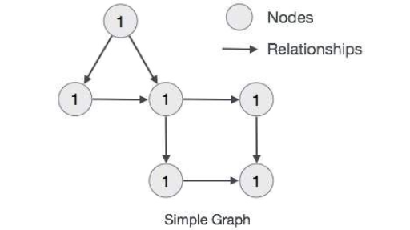
Graph DB Data Model
Structure
Nodes
Relationships
Properties :
We can represent Node's data in terms of Properties (key-value pairs) . we have represented each Node's Id property within the Node's Circle.
10

Slide 11
02
Installation
11

Slide 12
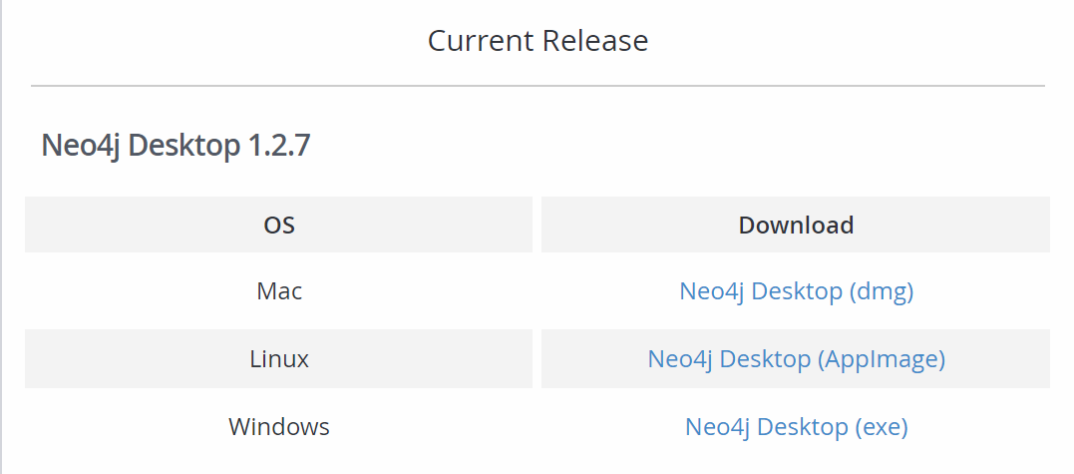
Installation
Go to https://neo4j.com/download-center/#desktop and download depend on your os.
12

Slide 13
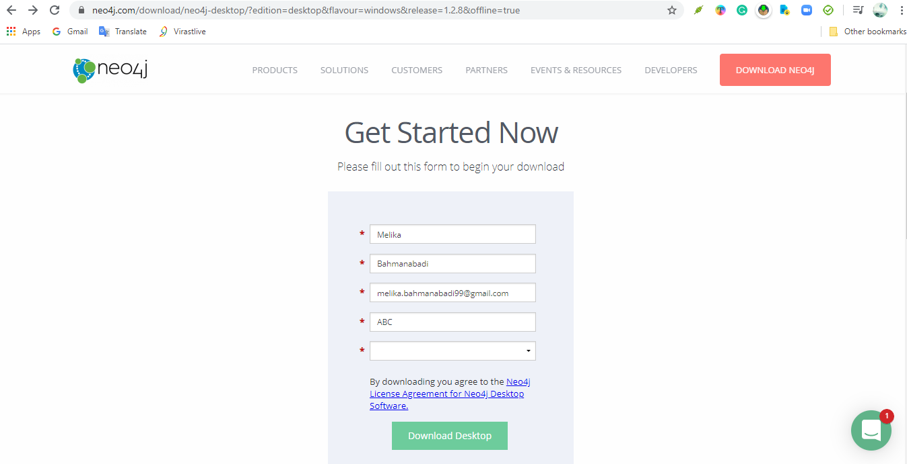
Installation
After filling the form click on Download Desktop.
13

Slide 14
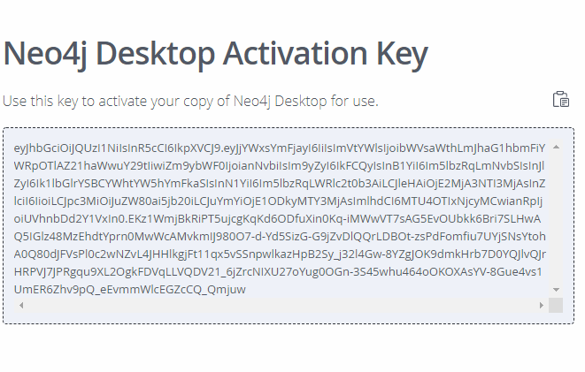
Installation
Copy the activation key.
14

Slide 15
03
Structure
15

Slide 16
Neo4j Graph Database building blocks
Nodes
Properties
Relationships
Labels
16

Slide 17
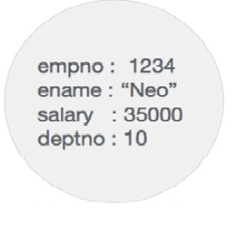
Node
Node is a fundamental unit of a Graph. It contains properties with key-value pairs as shown in the image.
Here, Node Name = "Employee" and it contains a set of properties as key-value pairs.
Property is a key-value pair to describe Graph Nodes and Relationships.
(key = value) : Where Key is a String and Value may be represented using any Neo4j Data types.
Employee Node
17

Slide 18
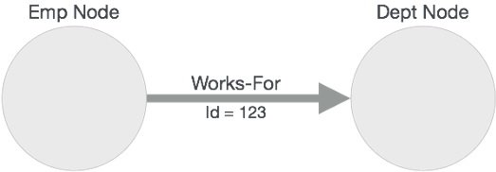
Relationship
JUPITER
Here, Emp and Dept are two different nodes. "WORKS_FOR" is a relationship between Emp and Dept nodes
Emp Works-For Dept
Here, "Emp" is a start node, and "Dept" is an end node.
"Incoming Relationship" to "Dept" Node and "Outgoing Relationship" to "Emp" node.
Here, "WORKS_FOR" relationship has one property as key-value pair.
Id = 123
It represents an Id of this relationship.
18

Slide 19
Labels
Label associates a common name to a set of nodes or relationships.
A node or relationship can contain one or more labels.
We can create new labels to existing nodes or relationships.
We can remove the existing labels from the existing nodes or relationships.
Left side node has a Label: "Emp" and the right side node has a Label: "Dept".
Relationship between those two nodes also has a Label: "WORKS_FOR".
Note : Neo4j stores data in Properties of Nodes or Relationships.
19

Slide 20
04
Neo4j CQL
20

Slide 21
Neo4j CQL - Introduction
CQL stands for Cypher Query Language. Like Oracle Database has query language SQL, Neo4j has CQL as query language.
Like Oracle SQL :
Neo4j CQL has commands to perform Database operations.
Neo4j CQL supports many clauses such as WHERE, ORDER BY, etc., to write very complex queries in an easy manner.
Neo4j CQL supports some functions such as String, Aggregation. In addition to them, it also supports some Relationship Functions.
21

Slide 22
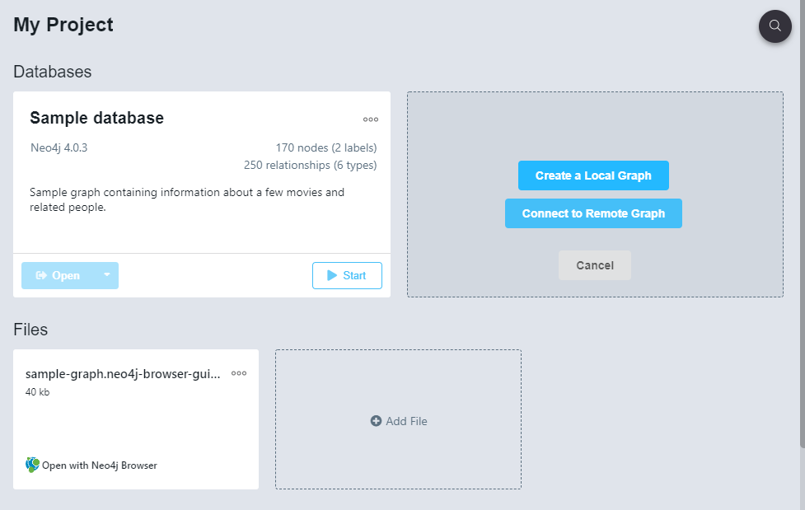
Create Graph
22

Slide 23
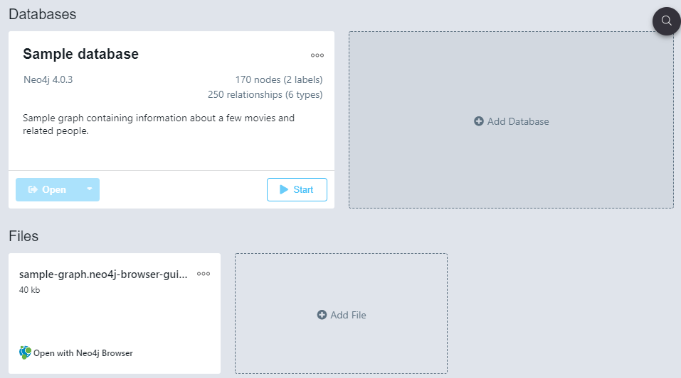
Create Graph
23

Slide 24
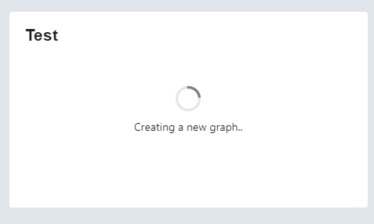
Create Graph
24

Slide 25
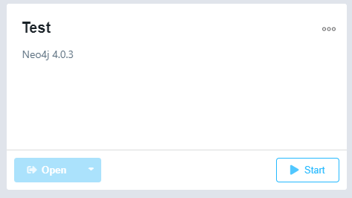
Create Graph
25

Slide 26
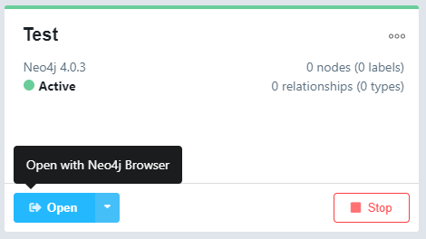
Create Graph
26

Slide 27

Create Nodes
27

Slide 28

Create Nodes
CREATE (node1),(node2)
28

Slide 29
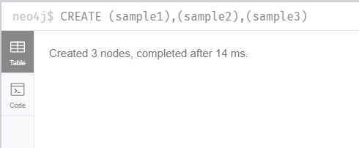
Create Nodes
29

Slide 30

Create Nodes with labels
CREATE (node:label1:label2:. . . . labeln)
30

Slide 31
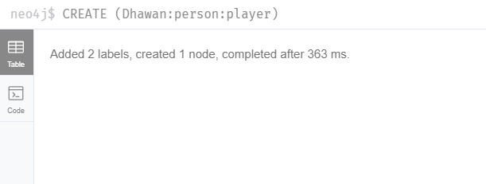
Create Nodes with labels
CREATE (node:label1:label2:. . . . labeln)
31

Slide 32
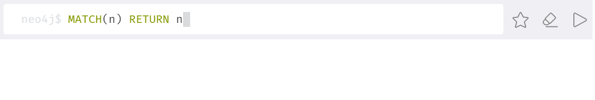
Create Nodes with labels
MATCH (n) RETURN n
32

Slide 33
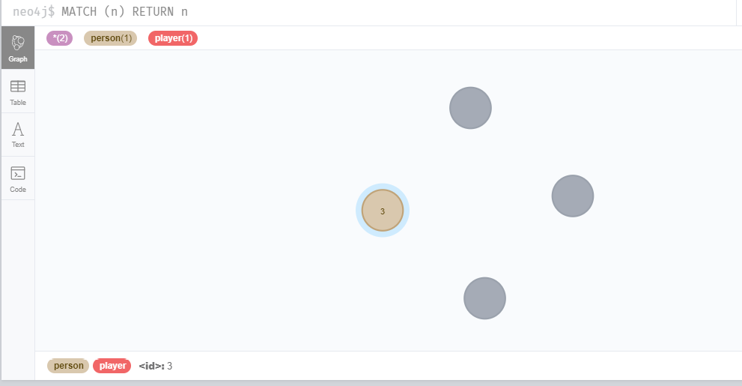
Create Nodes with labels
33

Slide 34

Create Node with Properties
CREATE (node:label { key1: value, key2: value, . . . . . . . . . })
34

Slide 35
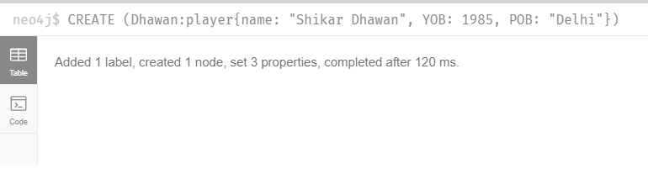
Create Node with Properties
CREATE (node:label { key1: value, key2: value, . . . . . . . . . })
35

Slide 36
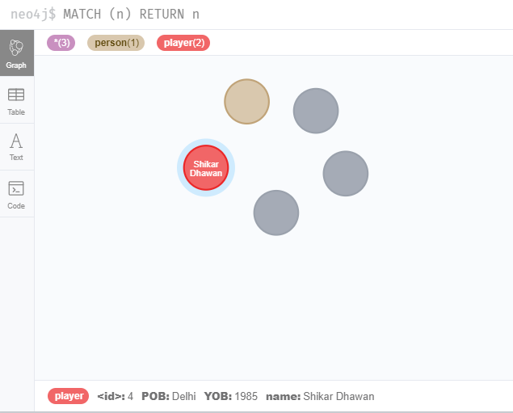
Create Node with Properties
MATCH (n) RETURN n
36

Slide 37

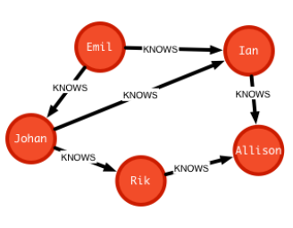
Create Relationship
37

Slide 38
Create Relationship
connect two nodes of a graph.
We can create a relationship using the CREATE clause.
between the existing nodes
with label and properties
38

Slide 39
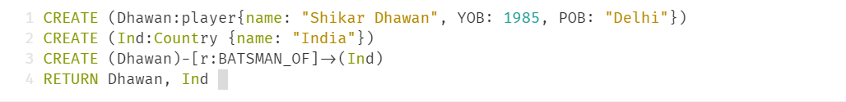
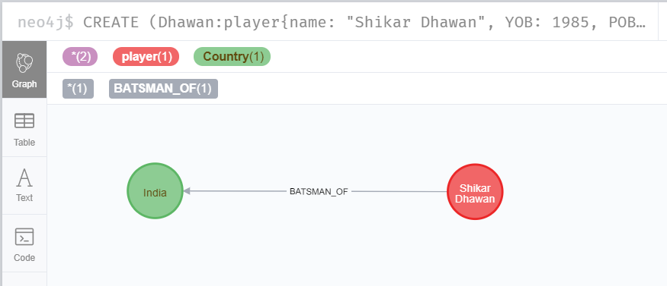
Create Relationship
39

Slide 40
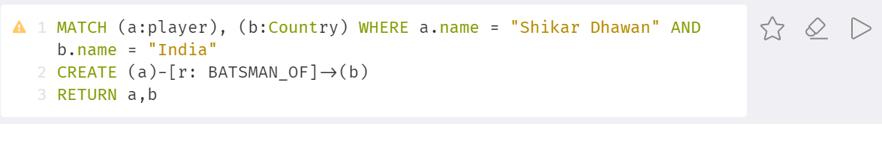
Creating a Relationship Between the Existing Nodes
MATCH (a:LabeofNode1), (b:LabeofNode2) WHERE a.name = "nameofnode1" AND b.name = " nameofnode2"
CREATE (a)-[: Relation]->(b)
RETURN a,b
40

Slide 41
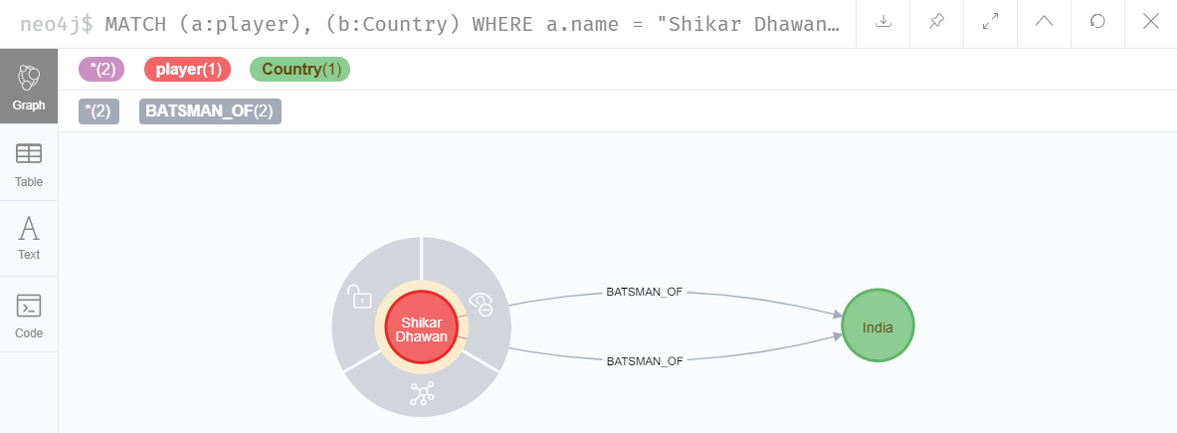
Creating a Relationship Between the Existing Nodes
41

Slide 42
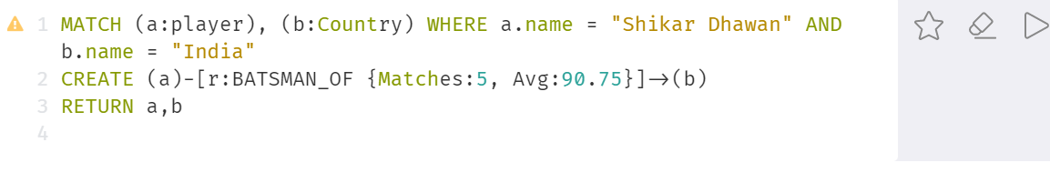
Creating a Relationship with Label and Properties
CREATE (node1)-[label:Rel_Type {key1:value1, key2:value2, . . . n}]-> (node2)
42

Slide 43
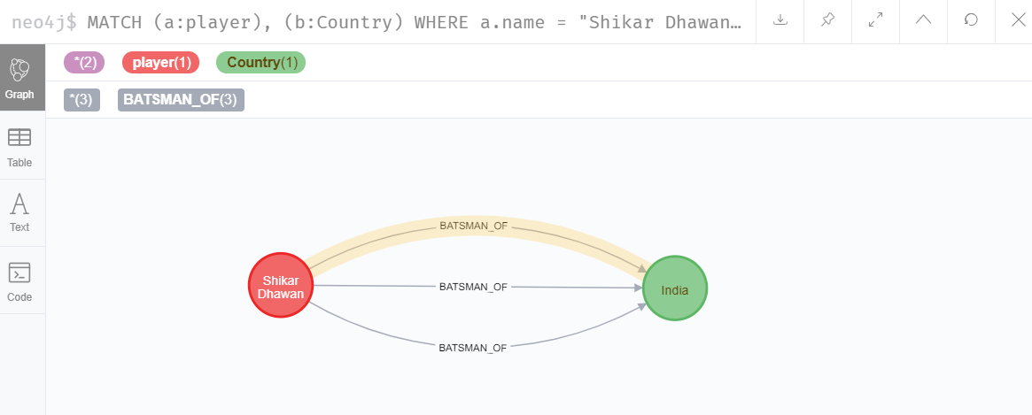
Creating a Relationship with Label and Properties
43

Slide 44
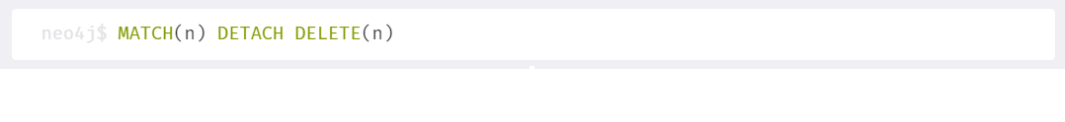
Deleting All Nodes and Relationships
MATCH (n) DETACH DELETE n
44

Slide 45


Deleting a Particular Node
MATCH (node:label {properties . . . . . . . . . . })
DETACH DELETE node
45

Slide 46
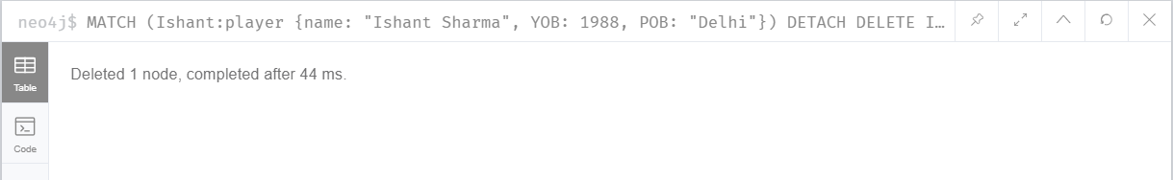
Deleting a Particular Node
46

Slide 47


Run Neo4j Desktop
47

Slide 48
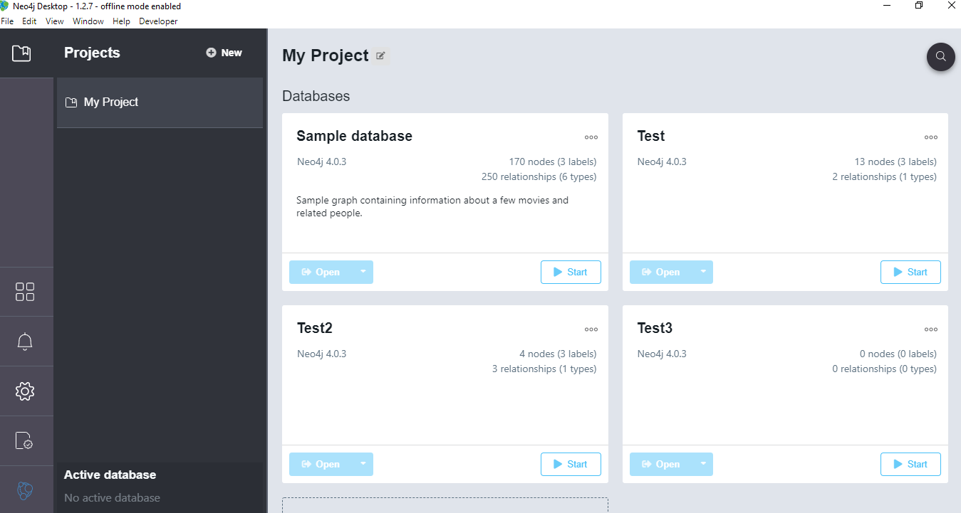
48

Slide 49
THANKS
Does anyone have any questions?
Melika.Bahmanabadi99@gmail.com
https://github.com/MelikaBahmanabadi
https://www.linkedin.com/in/melika-bahmanabadi-6729aa19a/
49

